Slide 1
U.S. Civil Affairs in Slovakia
CAT 0721

Slide 2
Who is Civil Affairs Team 0721
Name | Military Experience | Civilian Experience
CPT Jordan Simpson | 1 year Logistics 5 years Civil Affairs | Construction
SSG Nate Mitcavish | 2 years Chemical, Biological, Radiological, Nuclear 9 years Civil Affairs | Insurance Adjuster
SGT Anna Peterson | 8 years Civil Affairs | Phlebotomist
SPC Brad Specht | 6 years Personnel 1 year Civil Affairs | Diesel Mechanic

Slide 3


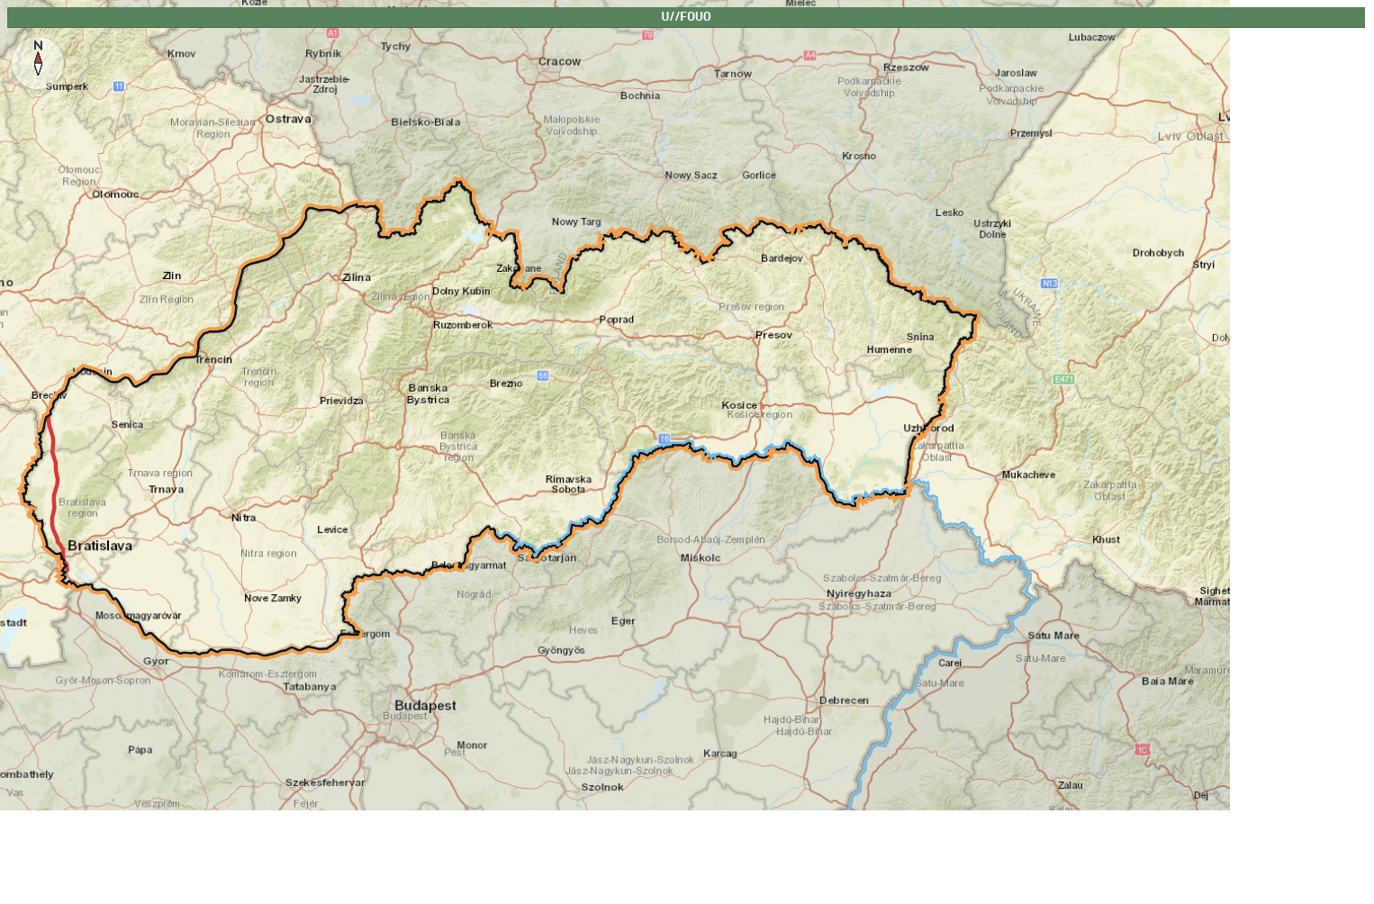







Operating Environment
Estonia
Latvia
Germany
Lithuania
Poland
CA
0721
B/407
Slovakia
Hungary

Slide 4
Mission Statement
Civil Affairs Team 0721 cooperates with Slovak Civil Military Cooperation (CIMIC) to establish partnerships with civilian and military organizations across Slovakia, support NATO exercises through mitigating military and civilian friction points, and conduct planning for future SVK-US opportunities.

Slide 5
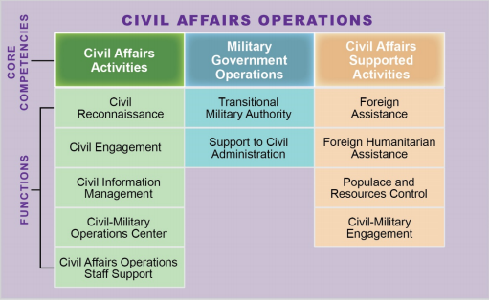
What is U.S. Civil Affairs?
Notes:
Civil Affairs operations are actions planned, coordinated, executed, and assessed to enhance awareness of, and manage the interaction with, the civil component of the operational environment; identify and mitigate underlying causes of instability within civil society; and/or involve the application of functional specialty skills normally the responsibility of civil government
The three CA core competencies nested within CAO describe the overarching capabilities that the CA branch provides. CA functions are aligned under the core competencies, organizing tasks and systems (people, organizations, information, and processes) into executable capabilities. These functions may be executed prior to, simultaneously with, or in the absence of other military operations, across the range of military operations and all levels of war.

Slide 6
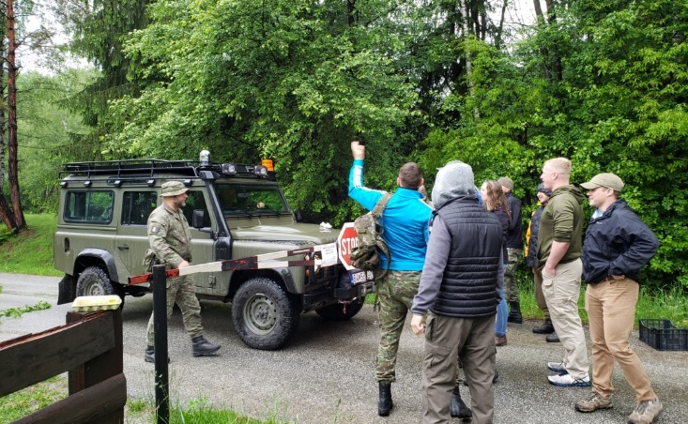
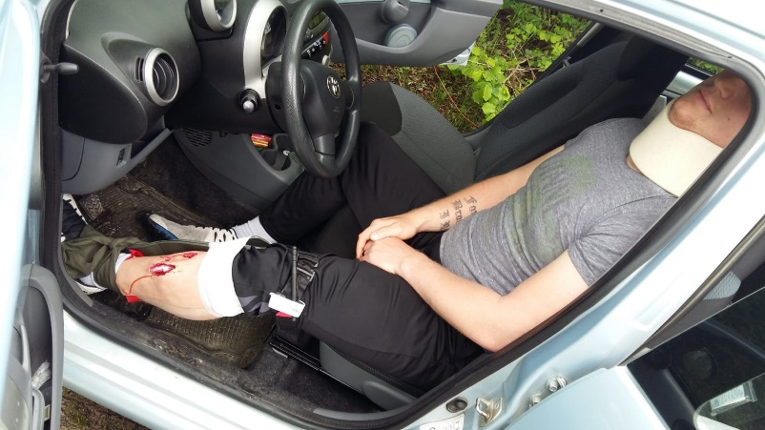
SVK-US Activities
Combined training events
  First Aid
  Joint Humanitarian Operations
  Use of an interpreter
  Land Navigation
  Weapons Training
  Community Outreach
  Peacekeeping Support Operations
  Noncommissioned Officer Professional Development Program

Slide 7
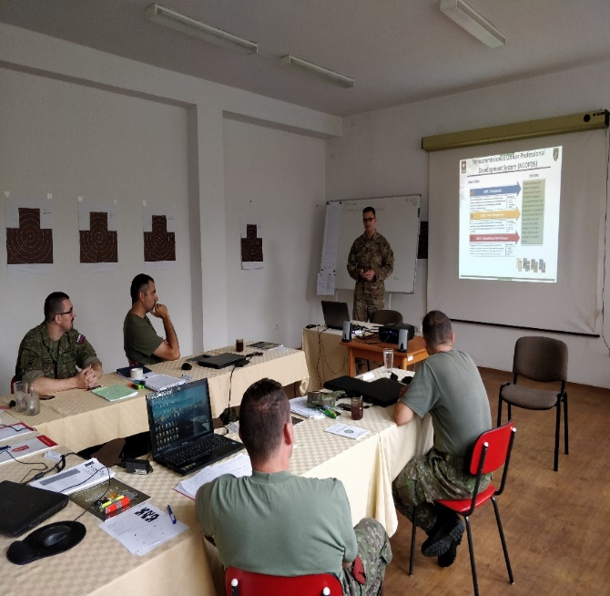
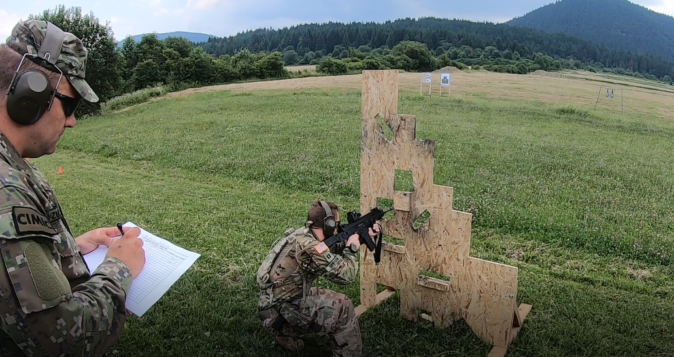
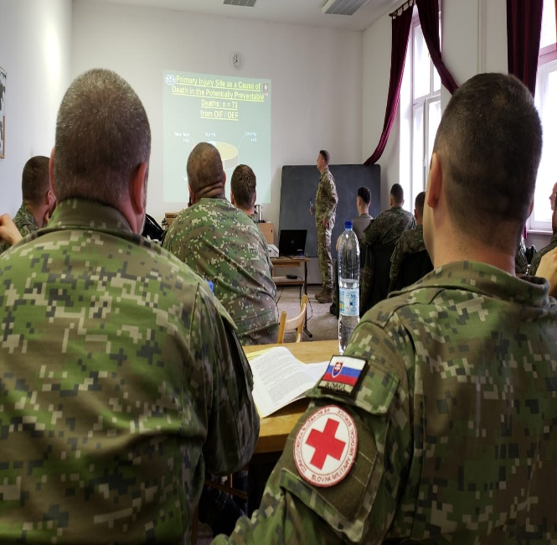
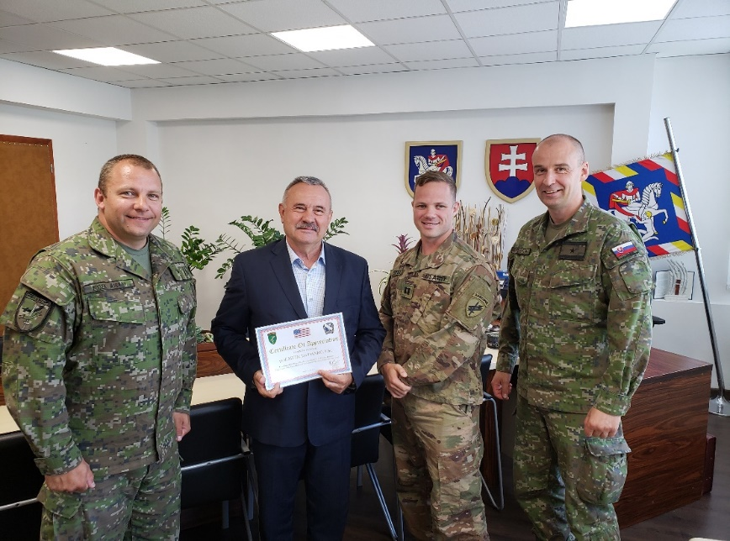
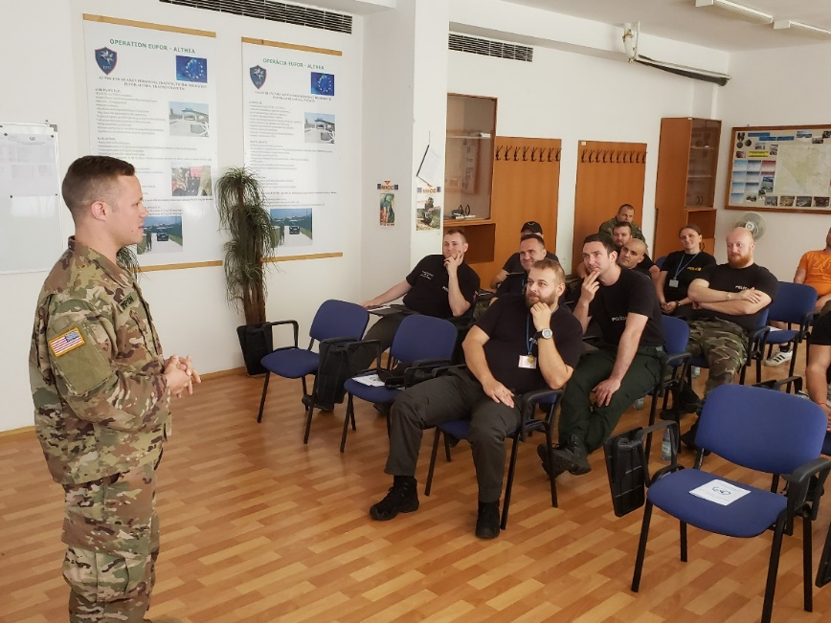
SVK-US Activities

Slide 8
Civil Affairs Team 0721
CPT Jordan Simpson, Team Chief
  +421 919 045 447
  thomas.j.simpson4.mil@mail.mil
SSG Nate Mitcavish, Team Sergeant
  +1.269.719.7290
  Nathaniel.e.Mitcavish.mil@mail.mil

